Slide 1


Slide 1
SHOPPING MALL SIMULATION
OOP PROJECT
ABDUL GHANI KHAN
INSTRUCTOR : USMAN WAJID

Slide 2
A Shopping Simulation :-
What is This For:-
Its a program where a buyer can buy anything in the mall.
The administration has the authority to add , remove , edit any section
of the Shopping Mall , for e.g a section of Fragrance And Clothing etc.
This Program gives the admin full control of the program making him
able to add any number of products in the section.
And the admin can add any number of sections.
Including all of these , the admin can add other admins or may be called
employees of the mall making it a fully usable program

Slide 3
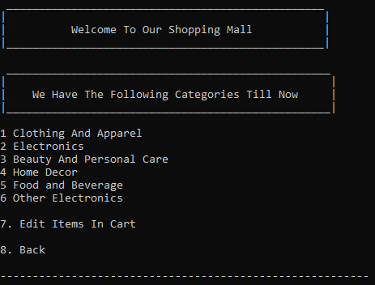
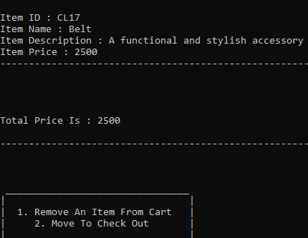
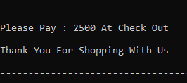
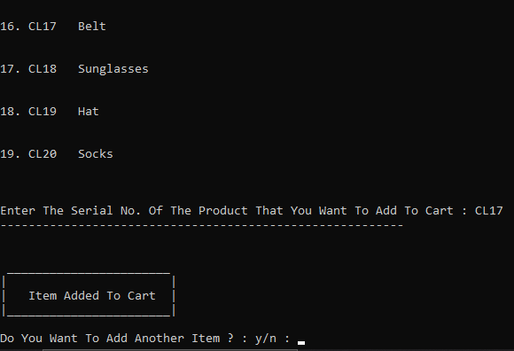
Buyer Point Of View:-
A buyer can simulate the software in different sections.
And in different sections he can add any product of his choice to the cart.
After the buyer is finished with his shopping he can move to the cart.
Where the buyer can choose to remove a product or add a new one or
move to check out .
When the buyer chooses checkout the program shows him his total bill
asks him to pay that amount at checkout.
After selecting checkout the program return to the main menu where it is ready for
The new buyer.

Slide 4
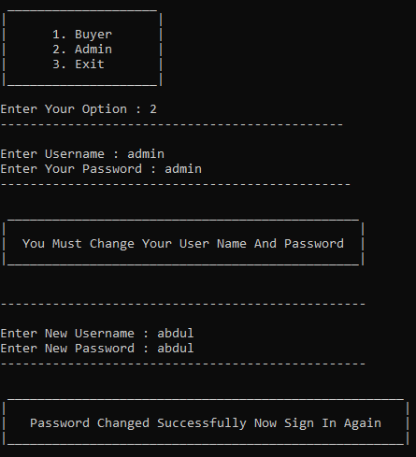
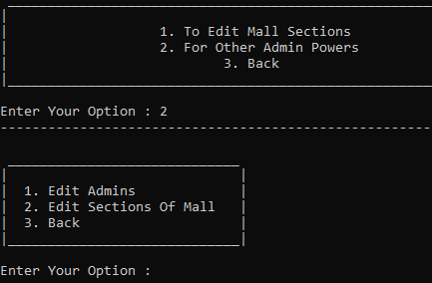
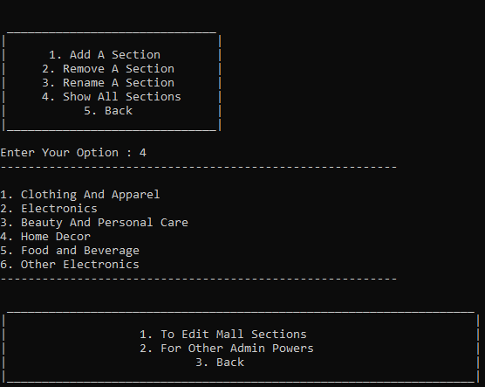
Admin Point Of View:-
The Admin when at the first time opens the program. To access the admin
panel he has to give the default username and password of admin , admin
respectively after which the program tells the admin to change his username
and password of course for safety reasons and then sign in again with the
new credentials.
After which he can then change his own password , add any number of other
admins , add any number of sections in the mall.
And including all these the admin can change the section name , change , delete ,
edit any product in any section.
With that it doesn’t come to an end the admin can also print all the sections of
the mall and can edit them too and also he can print all the products in a
particular section or even print a product by his serial number.

Slide 5
Concepts Used :-
Composition.
Dynamic Array.
Dynamic Array Of A Class.
Loops , Pointers and Many More.

Slide 6
In This Program The Shopping Mall Object is an object of a class that has
4 objects each of them is a dynamic array , and the Shopping Mall Object
is itself a dynamic array.
Also the Admin Object is an object of a class which is itself a dynamic array.
The Cart Is Also a dynamic array that destructs when the user selects checkout
every time.
The Class Of The Shopping Mall Object has 4 dynamic arrays because one
stores the serial number of the product the other its name , the other its description
the last one its price.

Slide 7
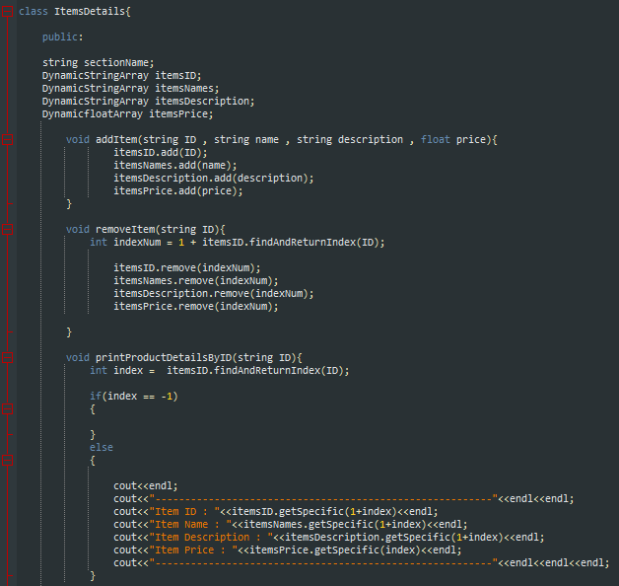
These Snippets Will Make You Understand

Slide 8
Slide 7
Product
Admin
Cart
Serial Num.
Name.
Description.
Price
Name / Username
Pasword
Can edit almost everything.
All The Products Added By The User
Including All The Info
Price
Description
Name
Serial Number
Total Price Of All Products.

Slide 9
Slide 8
Shopping Mall
Is a dynamic array.
Each index Which is a section has the following
Name
Dynamic Array : Serial Num (Obj Of Another Class)
Dynamic Array : Product Name (Obj Of Another Class)
Dynamic Array :Product Description (Obj Of Another Class)
Dynamic Array : Product Price (Obj Of Another Class)
Contact Me If You Want A
Copy Of The Program For Your
Use.

Slide 10

Slide 15
THANK YOU!
CONTACT AT:
Abdul Ghani Khan
p229037@pwr.nu.edu.pk

